Slide 1
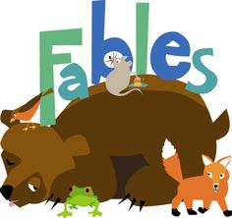

Slide 2
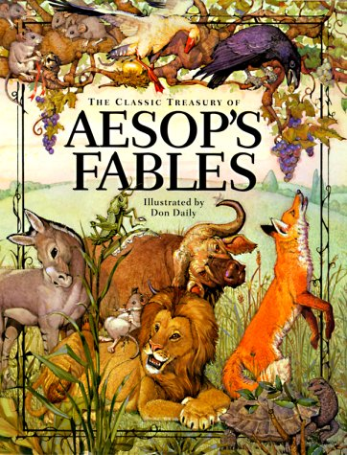
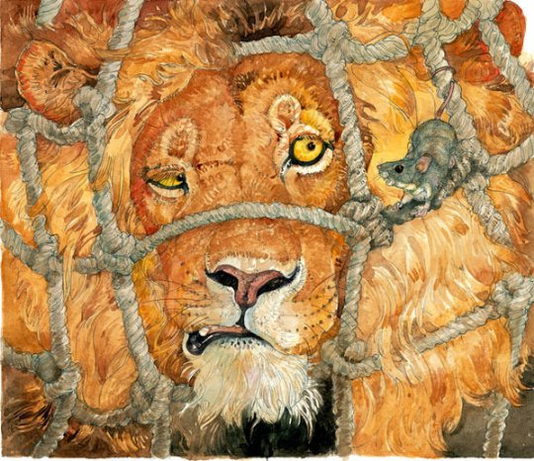
Tap into prior knowledge (what you already know!)
Aesop’s Fables
The Tortoise and the Hare
The Lion and the Mouse
The Ant and the Grasshopper

Slide 3
The Tortoise and the Hare
Video Rules:
Keep all comments to yourself
Watch the video silently
Listen carefully

Slide 4
The Tortoise and the Hare
https://www.youtube.com/watch?v=pjokVI0LJzw

Slide 5
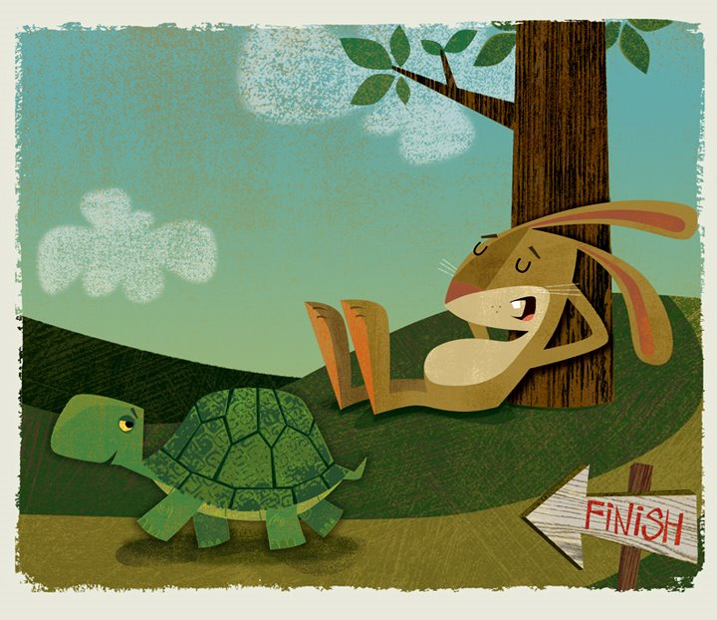
Talk at your tables about the video you just watched.
What is the story about?
The story is about ____________________.

Slide 6
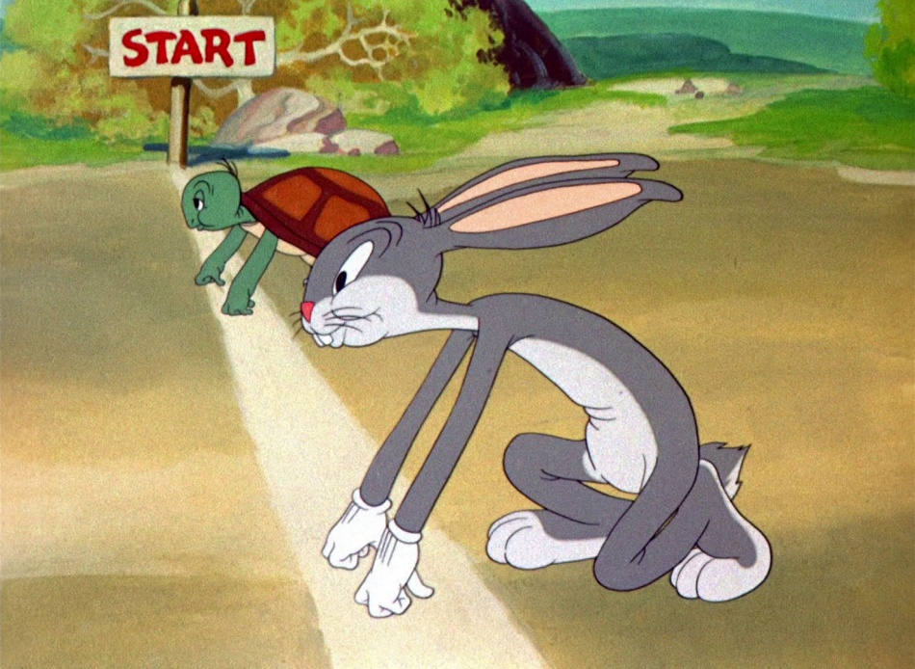
Fill in the first box in the chart under “summary”.
“The Tortoise and the Hare” is about ______________.

Slide 7
What is fable?
I know that the story is not real, because animals can’t speak human language.
I know the author is trying to teach us a lesson.
I think a fable is ___________________________.

Slide 8
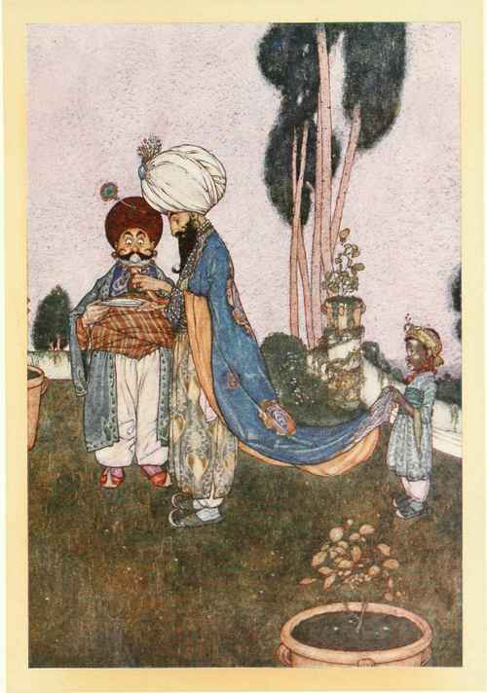
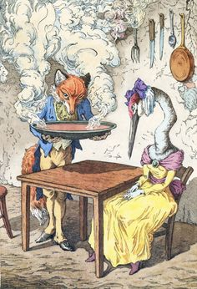
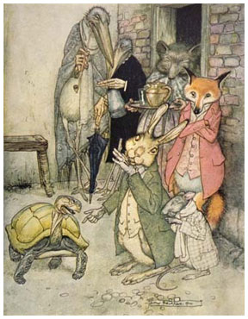
What is fable?
A fable is a short story that teaches a moral or lesson.

Slide 9
Lesson
A lesson is something that you’re learning.
What was the hare’s mistake? What did he do wrong?
The hare _____________________________.
What do you think the author is trying to teach us?
The author wants to teach us to _____________________________________.
Fill in the box under “lesson” in a complete sentence.

Slide 10
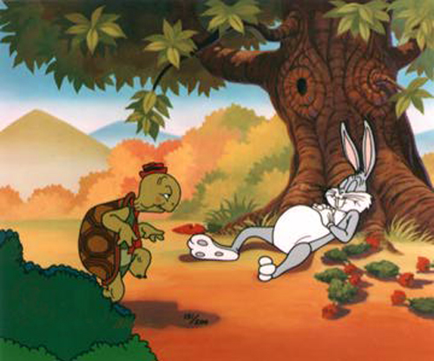
Fill in the box under “lesson” in a complete sentence.
The lesson of the story is to ______________________.

Slide 11
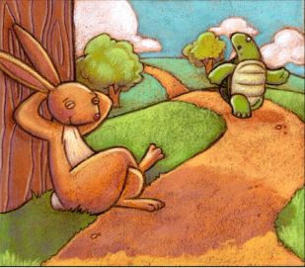
Fill in the box under “examples from the video” in a complete sentence.
Use an example from the story.
What did the hare learn?
In the story, the hare learned that _________________________________.

Slide 12
The Monkey and the Pea

Slide 13
India

Slide 14
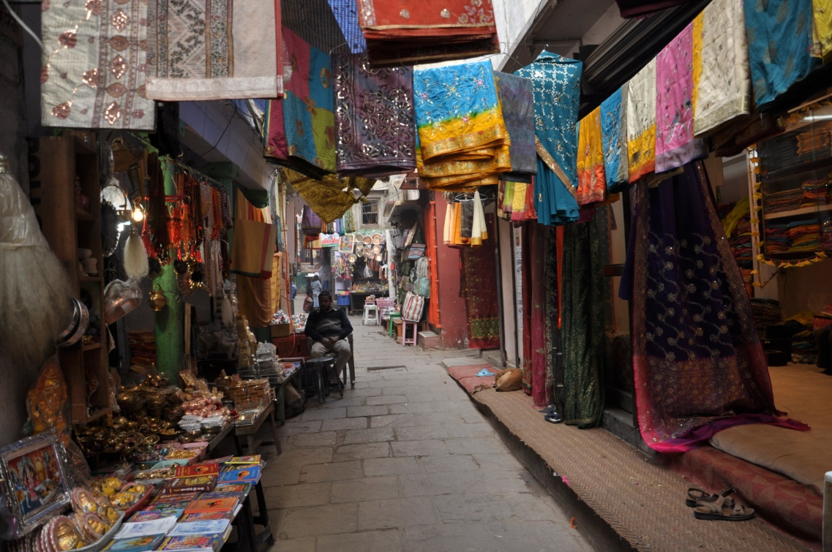
Benares (Varanasi)

Slide 15
Think about the lesson of the story.
Use one example from the reading that explains why you chose the lesson.

Slide 16
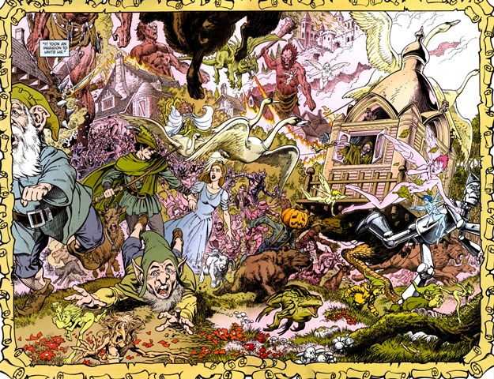
Closure
Share two things you learned in this lesson.

